Slide 1
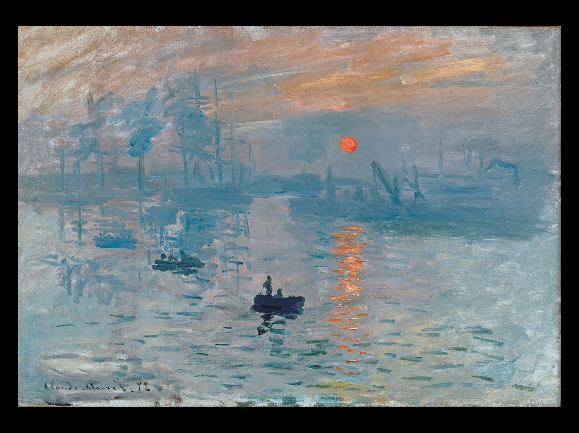
Claude Monet IMPRESSION: SUNRISE *** 1872. Oil on canvas, 19" × 24-3/8" (48 × 63 cm). Musée Marmottan, Paris. [Fig. 31-28]
Notes:
Claude Monet IMPRESSION: SUNRISE 1872. Oil on canvas, 19" × 24-3/8" (48 × 63 cm). Musée Marmottan, Paris. [Fig. 31-28]

Slide 2
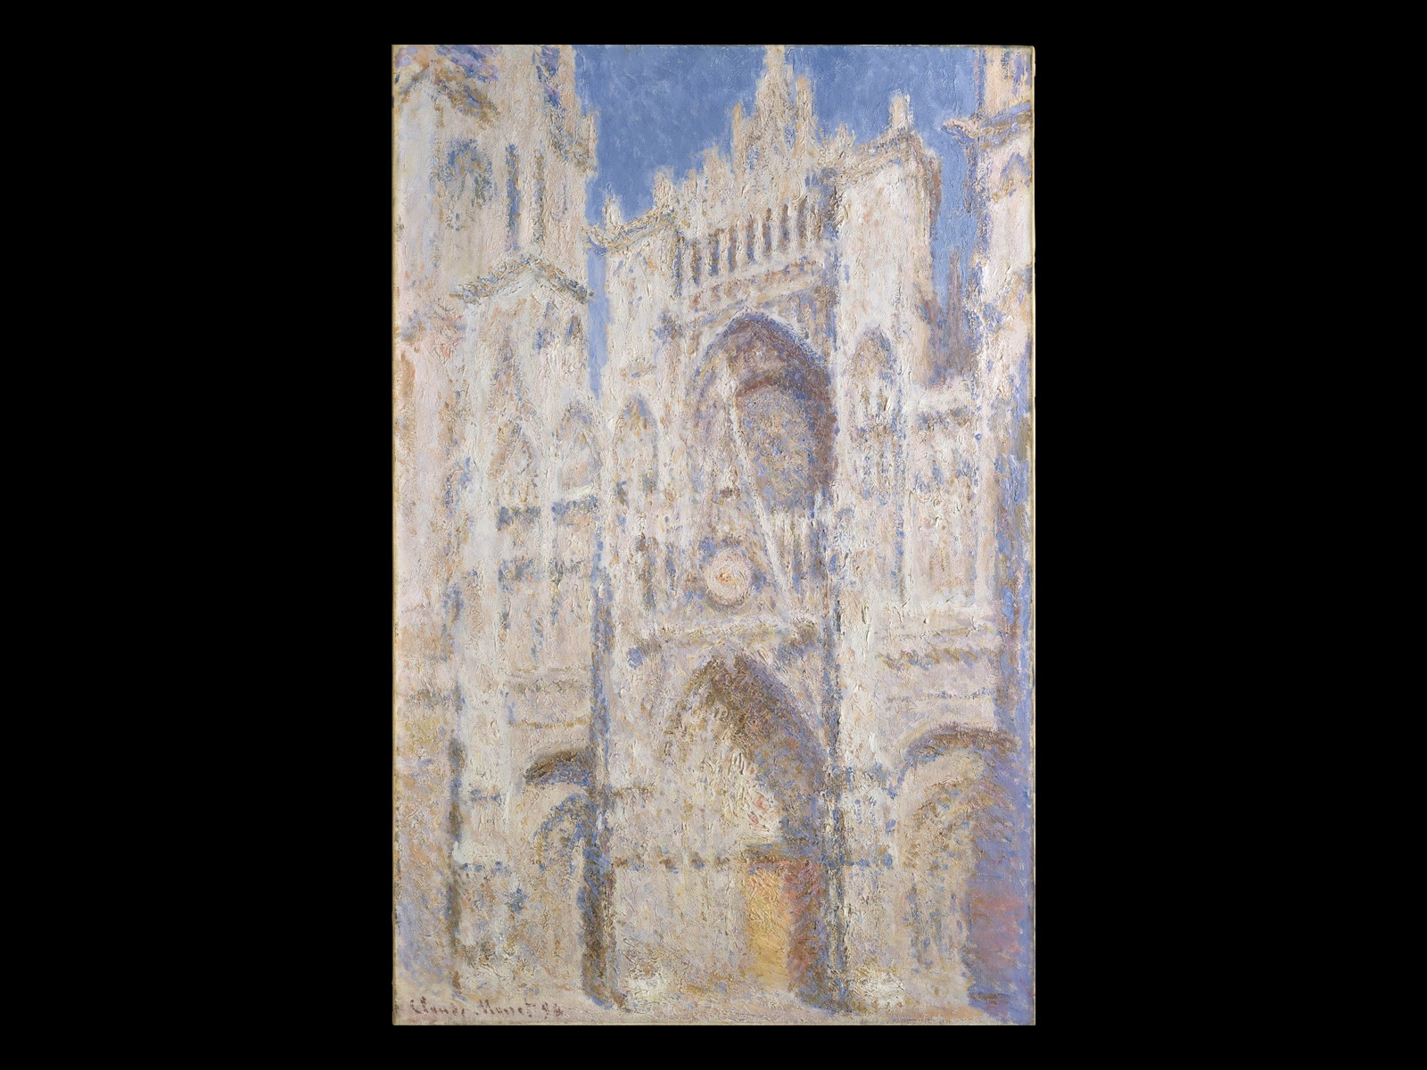
Claude Monet ROUEN CATHEDRAL: THE PORTAL (IN SUN)*** 1894. Oil on canvas, 39-1/4" × 26" (99.7 × 66 cm). Metropolitan Museum of Art, New York. [Fig. 31-29]
Notes:
Claude Monet ROUEN CATHEDRAL: THE PORTAL (IN SUN) 1894. Oil on canvas, 39-1/4" × 26" (99.7 × 66 cm). Metropolitan Museum of Art, New York. [Fig. 31-29]

Slide 3
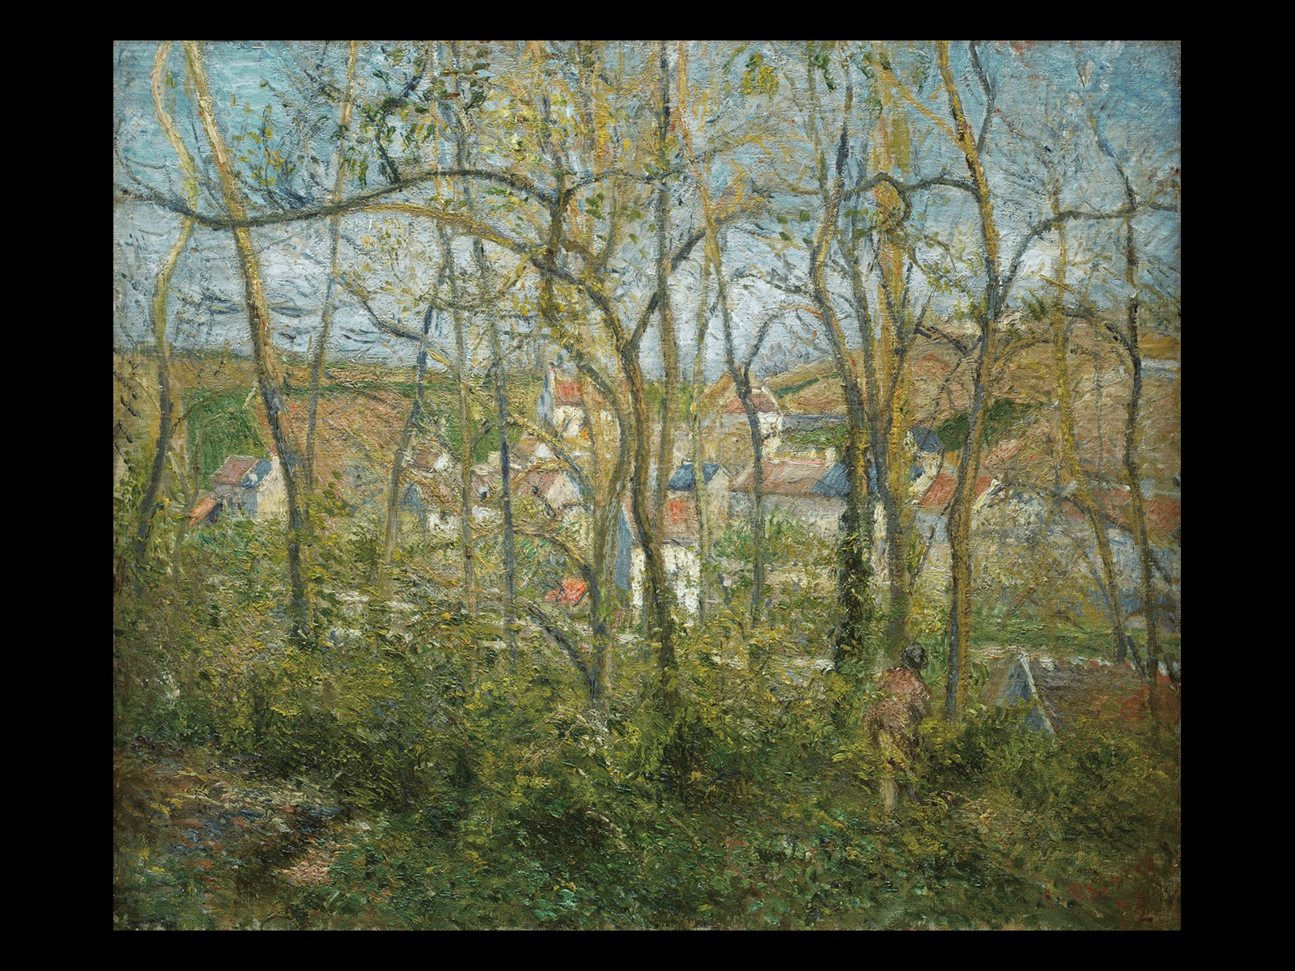
Camille Pissarro WOODED LANDSCAPE AT L'HERMITAGE, PONTOISE 1878. Oil on canvas, 18-5/16" × 22-1/16" (46.5 × 56 cm). Nelson-Atkins Museum of Art, Kansas City, Missouri. Gift of Dr. and Mrs. Nicholas S. Pickard [Fig. 31-30]
Notes:
Camille Pissarro WOODED LANDSCAPE AT L'HERMITAGE, PONTOISE 1878. Oil on canvas, 18-5/16" × 22-1/16" (46.5 × 56 cm). Nelson-Atkins Museum of Art, Kansas City, Missouri. Gift of Dr. and Mrs. Nicholas S. Pickard [Fig. 31-30]

Slide 4
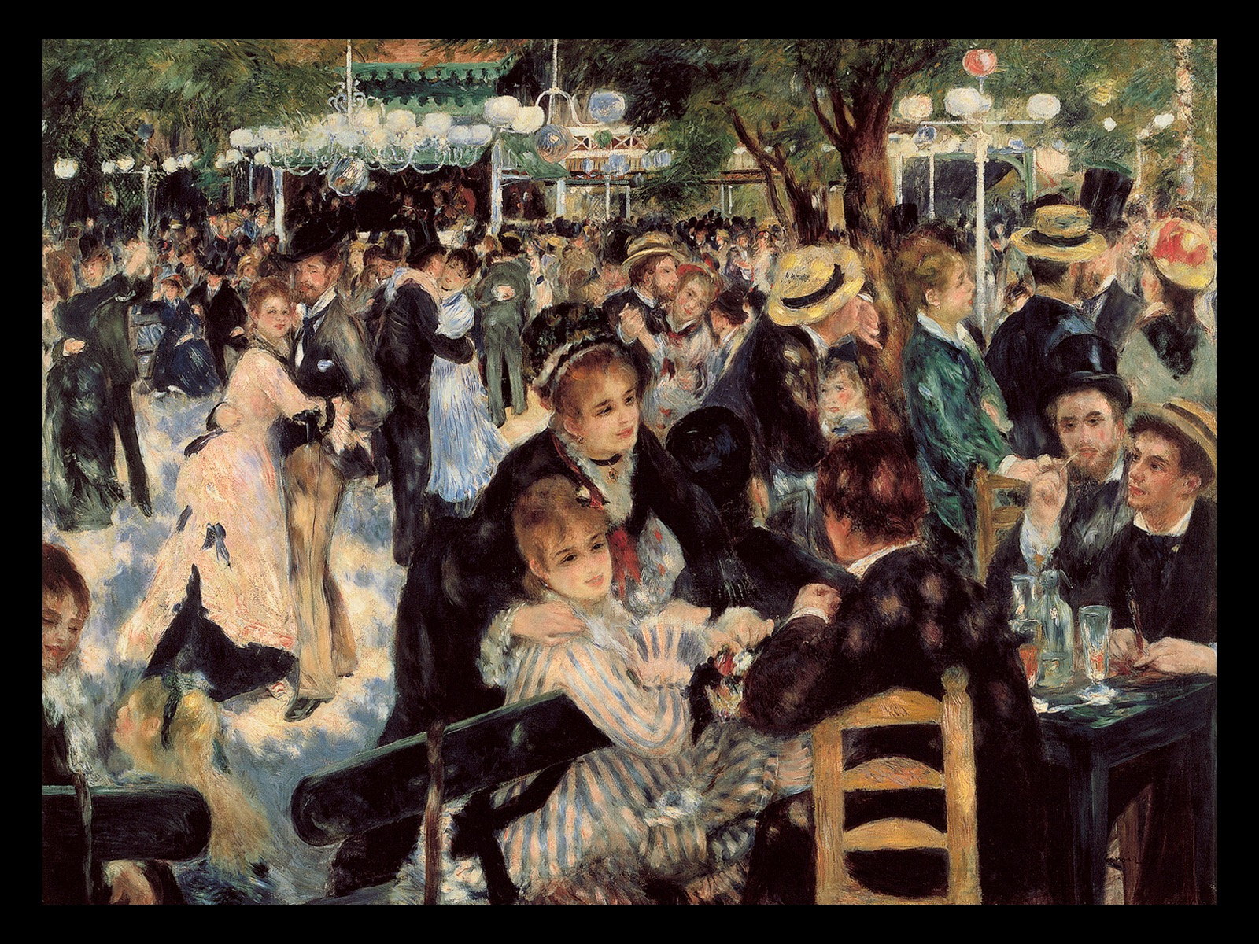
Pierre-Auguste Renoir MOULIN DE LA GALETTE *** 1876. Oil on canvas, 4'3-1/2" × 5'9" (1.31 × 1.75 m). Musée d'Orsay, Paris. [Fig. 31-31]
Notes:
Pierre-Auguste Renoir MOULIN DE LA GALETTE 1876. Oil on canvas, 4'3-1/2" × 5'9" (1.31 × 1.75 m). Musée d'Orsay, Paris. [Fig. 31-31]

Slide 5
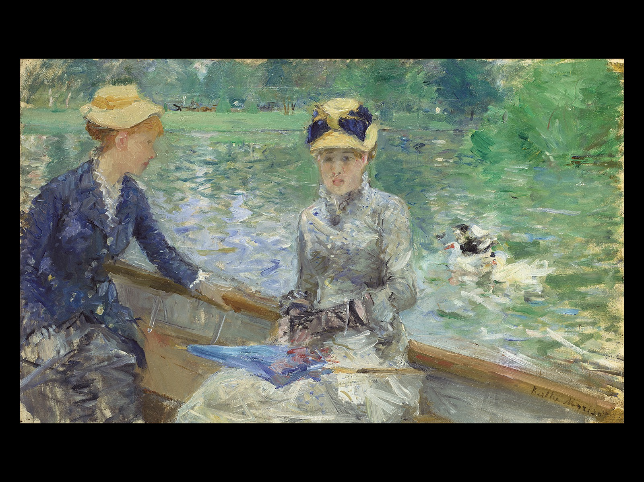
Berthe Morisot SUMMER'S DAY *** 1879. Oil on canvas, 17-13/16" × 29-5/16" (45.7 × 75.2 cm). National Gallery, London. Lane Bequest, 1917 [Fig. 31-32]
Notes:
Berthe Morisot SUMMER'S DAY 1879. Oil on canvas, 17-13/16" × 29-5/16" (45.7 × 75.2 cm). National Gallery, London. Lane Bequest, 1917 [Fig. 31-32]

Slide 6
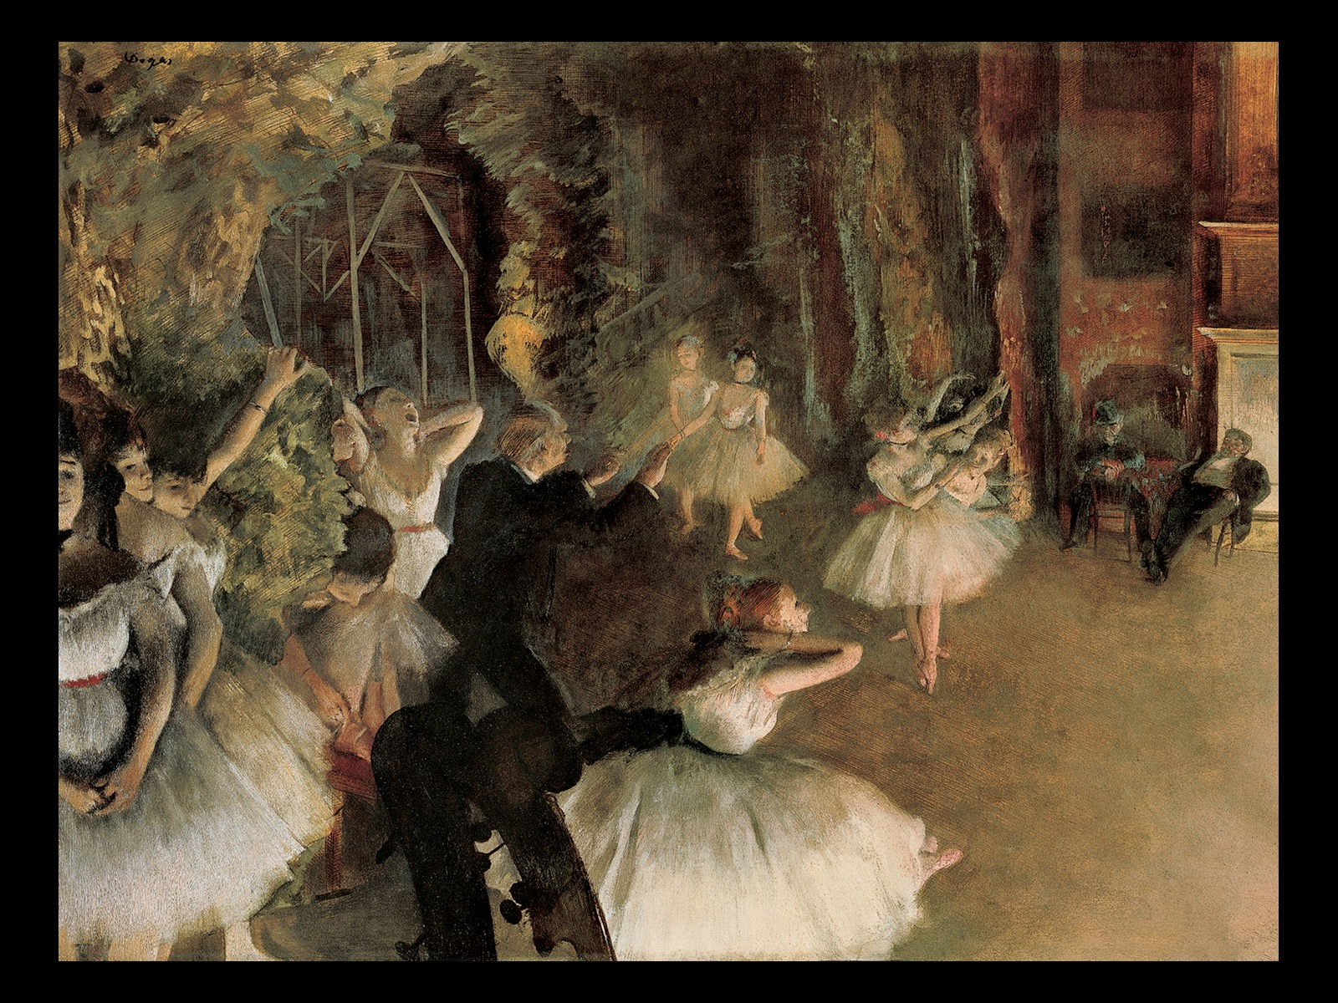
Edgar Degas THE REHEARSAL ON STAGE c. 1874. Pastel over brush-and-ink drawing on thin, cream-colored wove paper, laid on bristol board, mounted on canvas, 21-3/8" × 28-3/4" (54.3 × 73 cm). Metropolitan Museum of Art, New York. Bequest of Mrs. H. O. Havemeyer Collection, Gift of Horace Havemeyer, 1929 (29.160.26) [Fig. 31-33]
Notes:
Edgar Degas THE REHEARSAL ON STAGE c. 1874. Pastel over brush-and-ink drawing on thin, cream-colored wove paper, laid on bristol board, mounted on canvas, 21-3/8" × 28-3/4" (54.3 × 73 cm). Metropolitan Museum of Art, New York. Bequest of Mrs. H. O. Havemeyer Collection, Gift of Horace Havemeyer, 1929 (29.160.26) [Fig. 31-33]

Slide 7
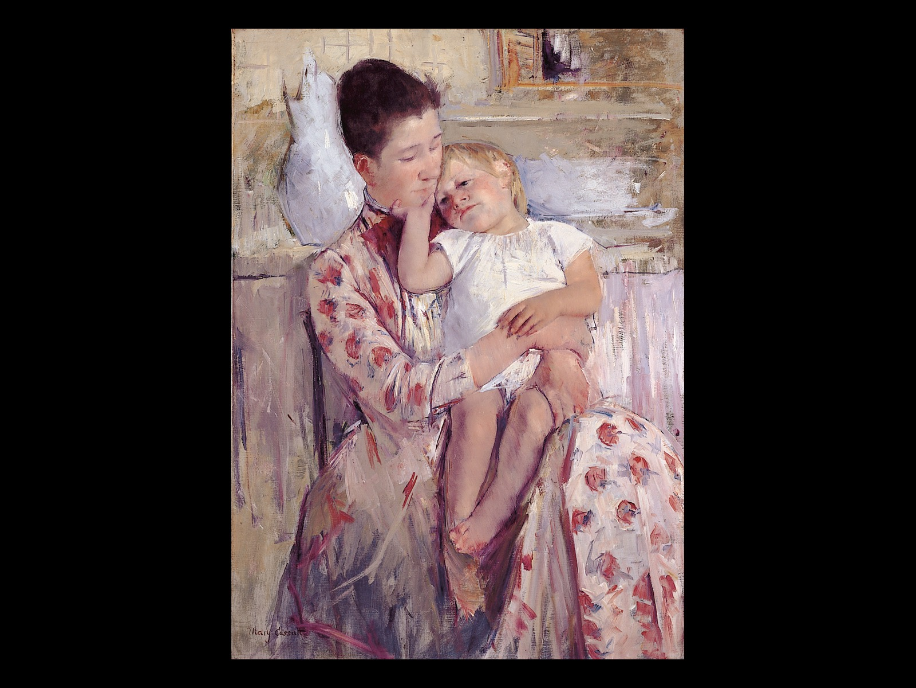
Mary Cassatt MOTHER AND CHILD c. 1890. Oil on canvas, 35-1/2" × 25-3/8" (90.2 × 64.5 cm). Wichita Art Museum, Kansas. [Fig. 31-35]
Notes:
Mary Cassatt MOTHER AND CHILD c. 1890. Oil on canvas, 35-1/2" × 25-3/8" (90.2 × 64.5 cm). Wichita Art Museum, Kansas. [Fig. 31-35]

Slide 8
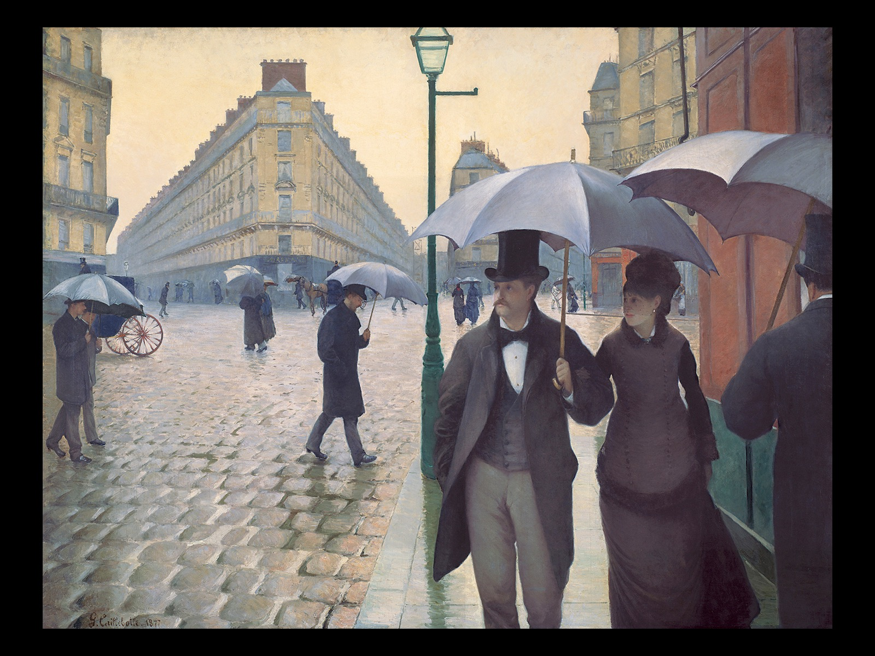
Gustave Caillebotte PARIS STREET, RAINY DAY 1877. Oil on canvas, 83-1/2" × 108-3/4" (212.2 × 276.2 cm). The Art Institute of Chicago. Charles H. and Mary F.S. Worcester Collection (1964.336) [Fig. 31-36]
Notes:
Gustave Caillebotte PARIS STREET, RAINY DAY 1877. Oil on canvas, 83-1/2" × 108-3/4" (212.2 × 276.2 cm). The Art Institute of Chicago. Charles H. and Mary F.S. Worcester Collection (1964.336) [Fig. 31-36]

